Slide 1
Enhancing the functionality and adding remote control capability to an I14 instrument using a Raspberry Pi
Alexander Liptak
Notes:
Hi everyone…
Introduce, Alex, Masters student, Theoretical Physics @ RHUL
Project title is <TITLE>
Alright, let’s get started

Slide 2
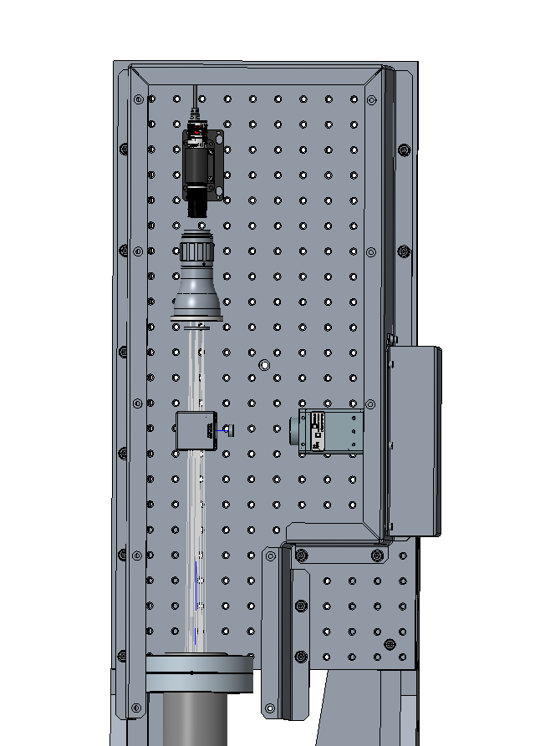
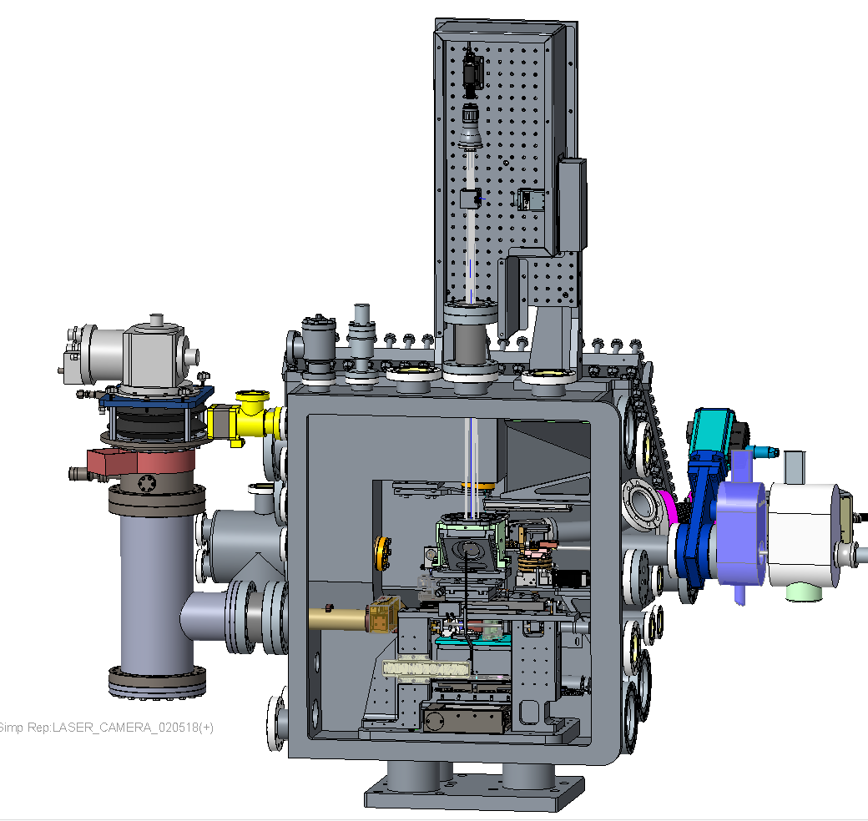
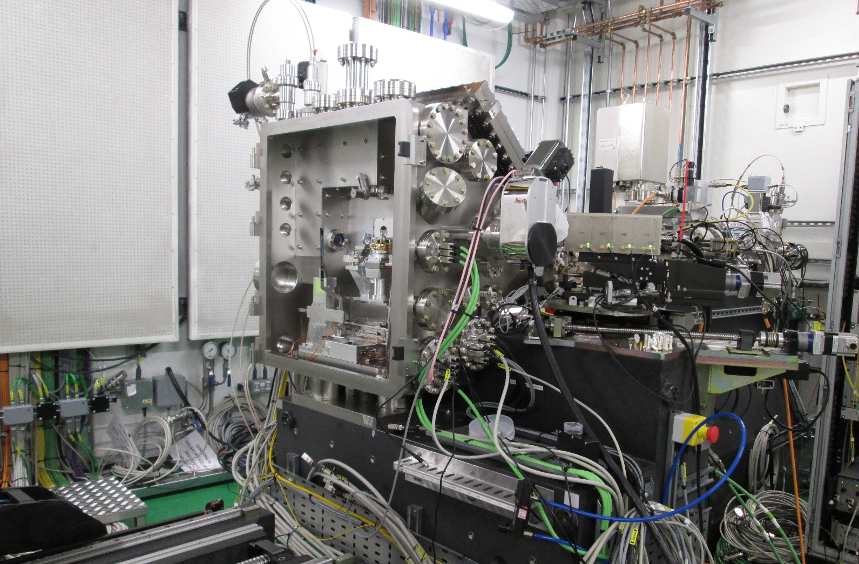
Introduction
Notes:
This is a view inside I14
I14 is the “Hard X-ray Nanoprobe”, deals with nano stuff
There is also a custom microscope, which uses a laser and some optics in order to essentially, find where the sample is in the beam, because it is so small
Because its custom, it is simple to use but not very convenient
The laser would be operated manually, you’d have to stand there and switch it on
Would need to break the safety interlock to control it
Motivation for the project: add remote control capabilities
This project then evolved into making a smart networked laser, with various other features that I will talk about later
Or, making a template for anyone who wants to network their equipment, who is inspired by this, etc (don’t hesitate to hit me or Fernando up)

Slide 3
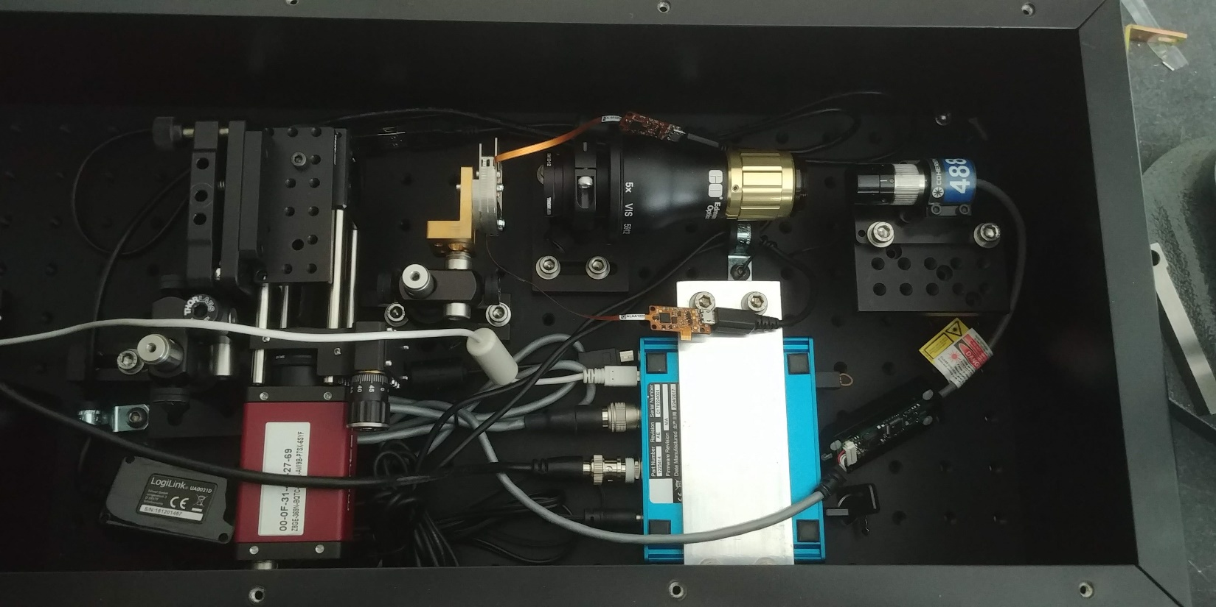
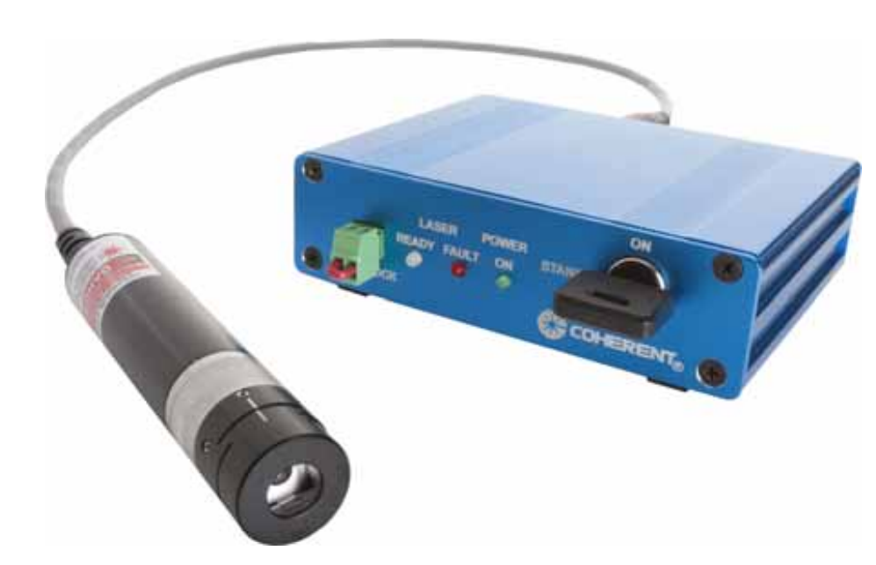
Laser
Notes:
Here is a picture of the laser instead of the diagram
The laser is here
Come with a nice controller unit there
Also camera in the corner

Slide 4
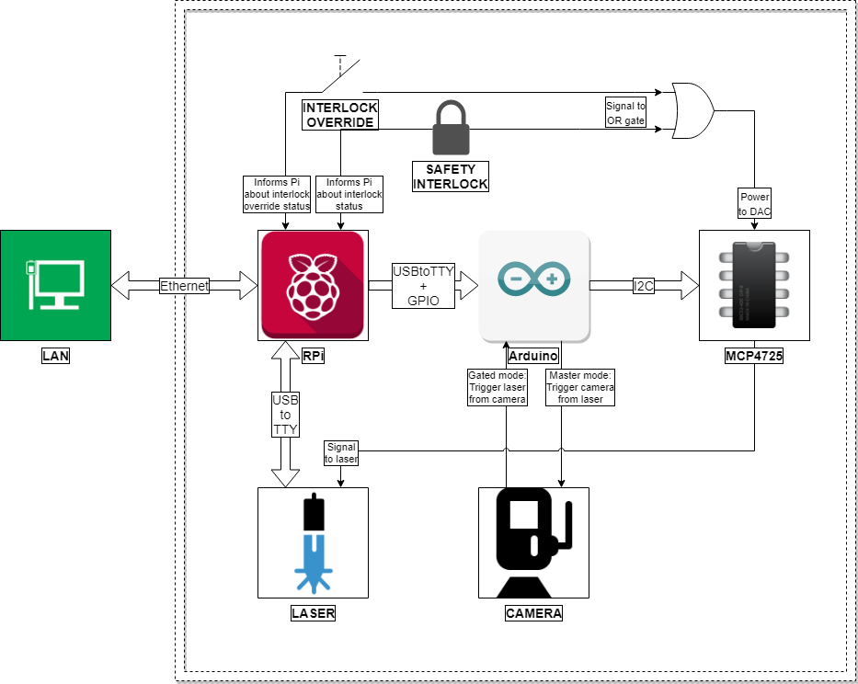
Project Map
Notes:
Say a person is running an experiment on I14 and need to use the laser
Previously, they would need to open the door to where the sample is, cutting off the security interlock, switching off the beam. Walk up to the laser, turn it on, carry out a search, close the door, and continue with their experiment. After they are done with the laser, the they would need to do the same thing just to switch it off, which they probably won’t. Say that the sample is sensitive to light and the laser is completely incinerating the sample, well tough. It is what it is.
A new proposed solution, looks like this (don’t be scared of by the diagram, I will walk you through it)
A person logs in to a computer on the diamond network, tells the laser turn on, and it does.
Also tells the laser to use only 20% of the power, or modulate the beam. More on that later. And it does, remotely, safely, and securely
The “brains” of this system would be the Raspberry Pi

Slide 5
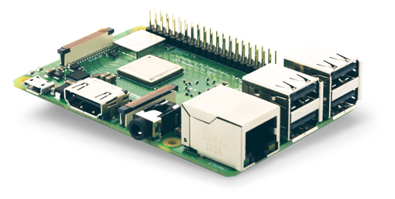

Raspberry Pi
Credit to Element 14
Link: http://au.element14.com/buy-raspberry-pi
Raspberry Pi is a trademark of the Raspberry Pi Foundation
Notes:
For those of you who don’t know
Raspberry Pi is a small credit-card sized computer
Speed comparable to a low-cost general-purpose PC
Chosen to act as a server in this project, and should be the only thing “visible” on the network.
Act’s as a gateway to the laser. If someone sends a command to turn the laser on over the network, it picks it up and after deciding it is safe and possible, it turns on the laser

Slide 6
Project Map
Notes:
The raspberry pi is directly connected to the laser controller, and carries whatever actions are needed with the laser
The raspberry pi is also directly connected to the arduino

Slide 7
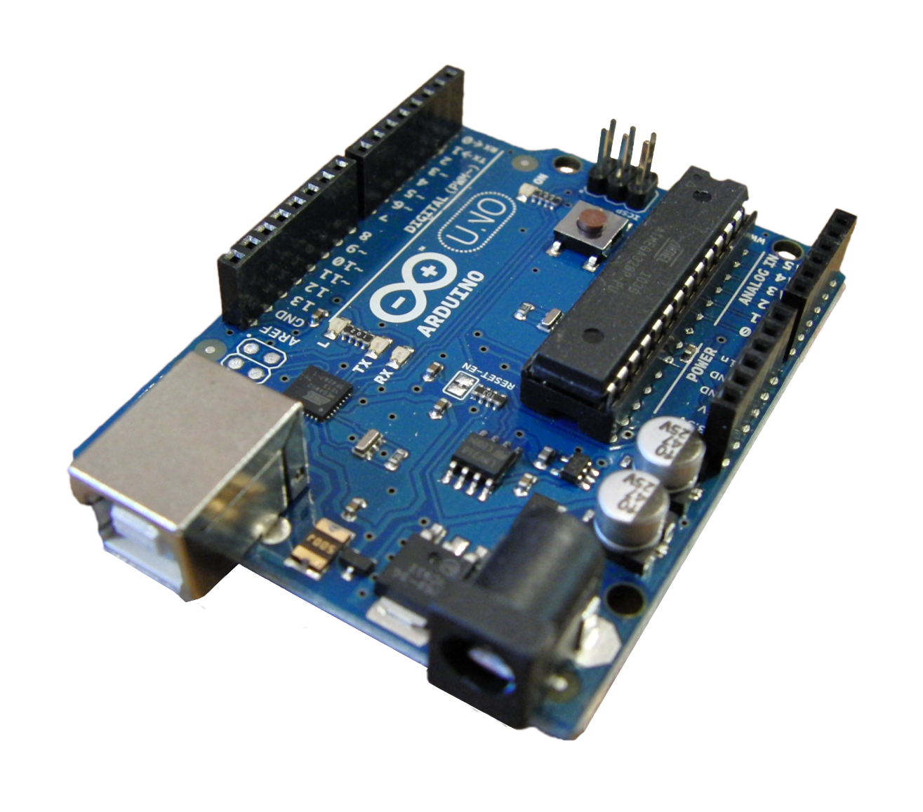
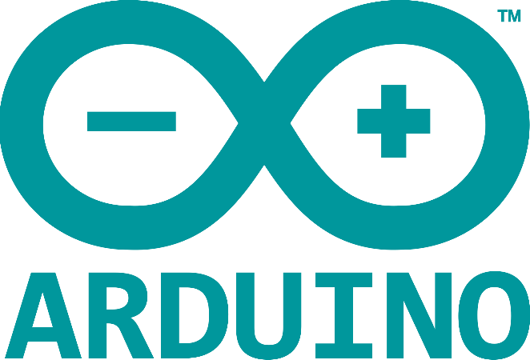
Arduino
"A Arduino Uno board" by JotaCartas, obtained from Wikimedia Commons, is licensed under CC BY 2.0
Arduino is a trademark of Arduino AG
Notes:
The Arduino, for those of you who don’t know, is a small microcontroller about the same size as the raspberry pi
It is similar to the raspberry pi, with one key difference in that it does only exclusively what it is told to do so, and usually does so very fast
Unlike a computer which as you know does a lot more things in background that you didn’t exactly tell it do to

Slide 8
Project Map
Notes:
The Arduino is useful here because it allows the Pi, which is in charge of communicating over the network, to do its own thing
The Arduino takes care of any heavy workload that needs to be done, such as modulation, which we mentioned previously.
The Arduino is connected to a DAC

Slide 9
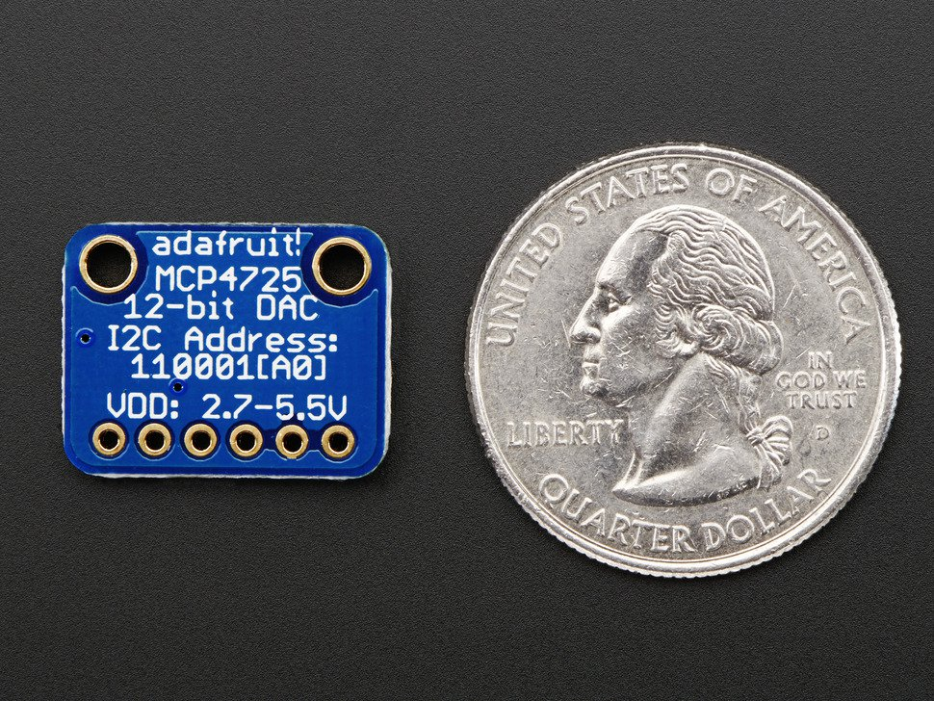
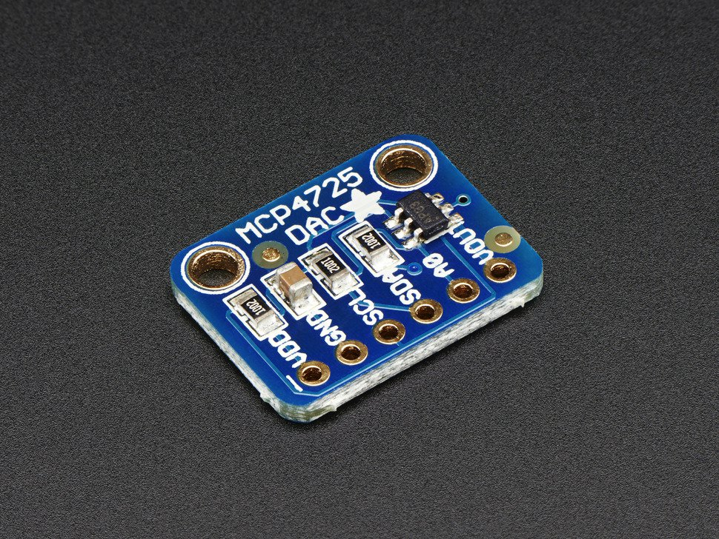
DAC
Credit to Adafruit
Link: https://www.adafruit.com/product/935
Notes:
The dac is a pretty small device, and what it does is that, it converts digital signals to analogue signals
Actually it is even small than that, but that gets pretty difficult to handle
This is useful because you can give it any number, and it outputs that as a percentage of voltage
Now besides settings voltage to lower values, in order to make sure the laser doesn’t burn anything, we can also use it to do modulation

Slide 10
Laser Modulation
Notes:
Modulation is essentially for sending signals to the laser to make sure that it doesn’t spend most of its time on high. By alternating between on and off, the average power delivered to the sample is lower than if it was constantly on.
This oscilloscope readout shows the laser is pulse mode, which is useful for studying samples which may be affected by light. Someone can say over the network, pulse the laser for half a second, with a 5 second wait between pulses. This is it
You can also create other interesting signals that can be fed into the laser, for example this a sawtooth wave
I am not sure if it has any significant scientific use but the option is here to use it, if anyone wants
The Arduino here is in charge of calculating the voltage at every single point in time, and the DAC then does it. The Arduino also ensures that, if you say you want, a sawtooth wave of 10Hz, you get it relatively high accuracy
Out of curiosity, I wanted to see what would happen when the system is pushed to its upper limit. This shows a sawtooth wave that is trying to be 500Hz, and not doing very well. You can see that the speed that the components communicate with each other, and by the time the DAC changes the voltage, the next change should have already happened. The Arduino compensates for this by cutting out parts of the wave, although this distorts the shape of the wave
Here is also a triangle wave (proud of the 10Hz)
An this is what happens when the triangle wave frequency is ramped up
Finally, here is a square wave. This is the most common of all the modulation types. By simple switching the laser on and off very fast, essentially, only half as much power is delivered to the laser. I say essentially because a full strength burst, even though over average it delivers less power, it can still damage the sample
Finally, here is the square wave at its maximum possible frequency, which is a massive 3000 Hz

Slide 11
Project Map
Notes:
Now we have talked about the DAC, the final component here I want to talk about is the camera
Although this is not fully implemented yet, the idea was that the camera, which can also be connected to the Arduino. The laser can then be set up as a slave to the camera, so if the camera is rolling at 20Hz, the laser bursts only when the camera is on. The other way round is also possible, where the Arduino generates some nice waves for the laser, and triggers the camera to detect accordingly
Finally what I want to talk about is safety
Now if we know anything about computers, it is that they fail way too often
This is not so okay when it comes to personal computers, and very much not okay when it comes to lasers and beamlines. Fortunately, a hardware safety mechanism is implemented. The power to the DAC, and therefore the laser, is wired directly to the safety interlock in the room where the experiments happen. Opening the door cuts the power to the system, meaning the laser is instantly switched off. The raspberry pi is aware of the gate, it knows whether it is on or off, and therefore can relay this to the person sitting on some computer. But it cannot control the gate
There is also an interlock override switch, in case you want to get adventurous and play with the laser while you are in the same room (as has been done before I came along). This is mostly for testing purposes, and makes you aware that you are overriding a safety mechanism by a loud annoying repetitive beep

Slide 12
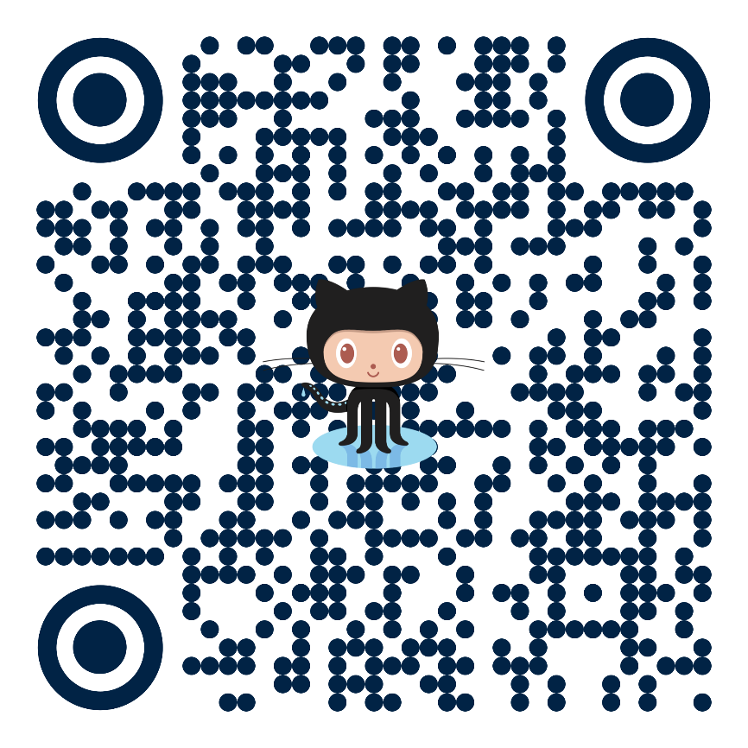
Conclusion
For more information contact:
Fernando Cacho-Nerin at fernando.cacho-nerin@diamond.ac.uk or Edmund Warrick at edmund.warrick@diamond.ac.uk
Notes:
So to conclude. This entire project is hosted on GitHub, here’s the QR code to it. I have also left contact addresses for my supervisors who would be happy to talk to you more about this project. Also, I would appreciate a GitHub message, it gets pretty lonely on there sometimes
The project was mostly a success, and although there were various road blocks encountered along the way, of various difficulty and length, the project left behind an almost complete solution and a well documented template for anyone who would like to follow the same steps I did, avoiding all the road blocks

Slide 13
Acknowledgements
Supervisors:
Fernando Cacho-Nerin
Edmund Warwick
Electronics help:
Ben Garvey
Diamond IT
Richard Cooper
Diamond Students team
Notes:
Thank you to Fernando and Ed for leading and guiding me through this project. A thank you also goes to Ben for helping me with all the weird and probably annoying electronics requests I made. Thank you Diamond IT, especially Richard Cooper whom I never met, but he got my raspberry pi on the network. And finally a special thanks to the Diamond Students team, without which this project, and me coming here, would not really be possible.

